Slide 1

CQRS – PRACTICAL GUIDE
Umamaheswaran
@UMW360

Slide 2
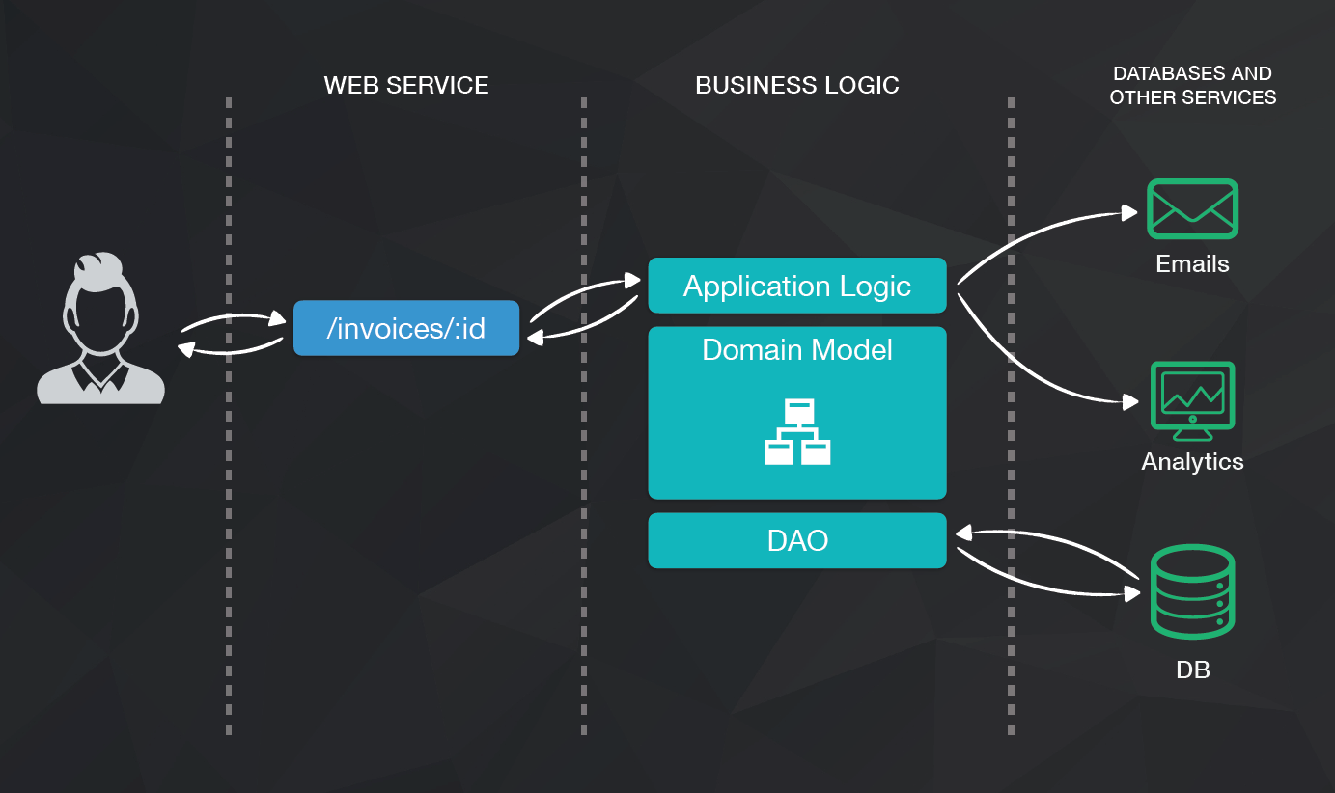

Slide 3


WE LOSE DATA BY DESIGN

Slide 4


Regulatory Compliance
Scalability
Ability to add new features easily

Slide 5

EVENT SOURCING
Express what the user wants in domain language

Slide 6
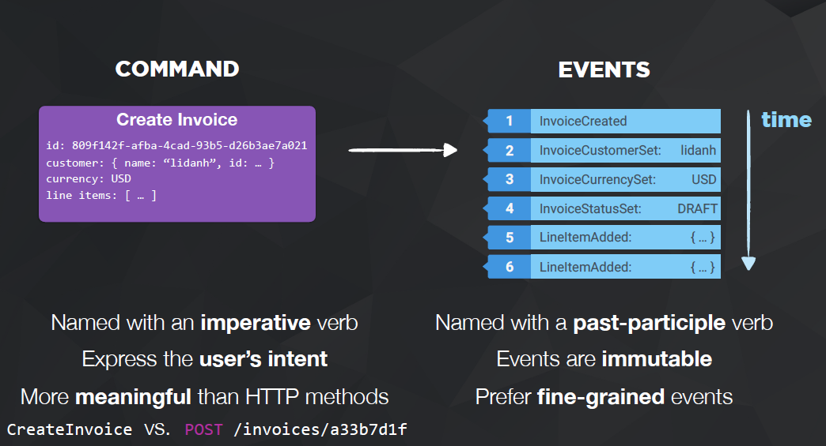

Slide 7
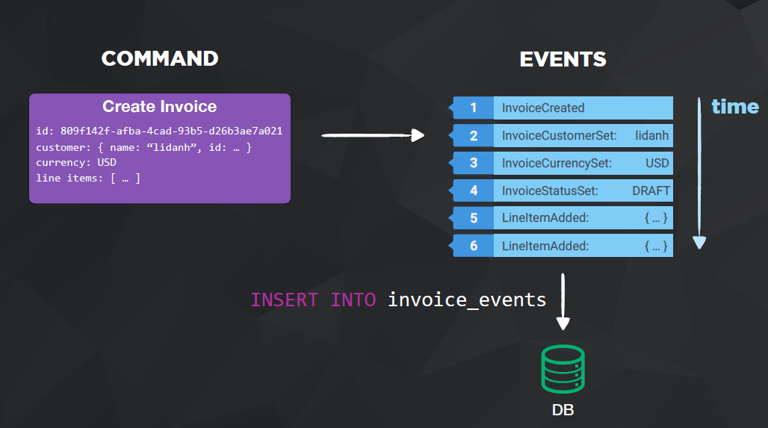

Slide 8
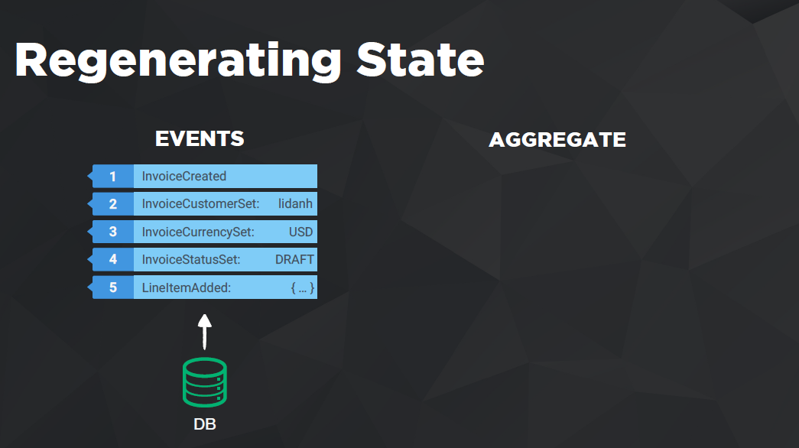

Slide 9
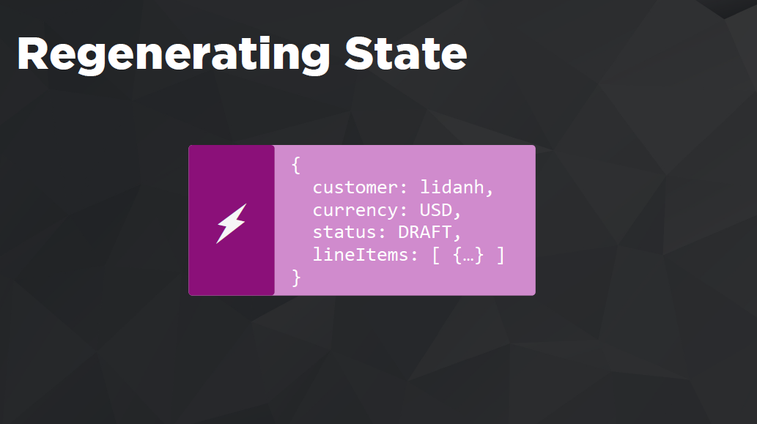

Slide 10

Regulatory Compliance
No data loss
Scalability
Ability to add new features easily

Slide 11
READS
WRITES
90%
10%
Easier to Scale
Flexible View Models
Normalized Forms
Validations

Slide 12


Slide 13
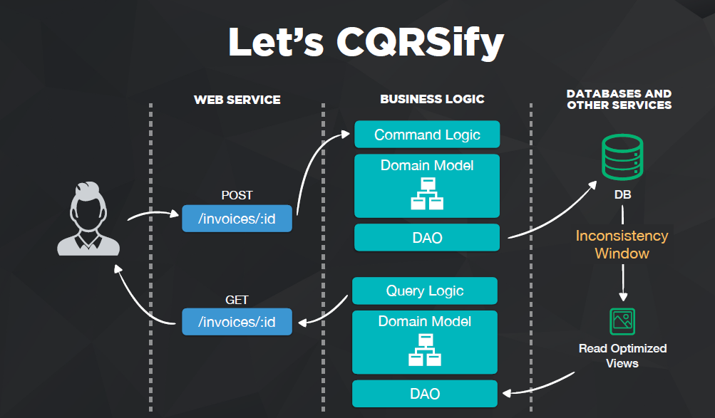

Slide 14

CQRS is an optimizing technique Do you really have scaling issues?

Slide 15
Scaling your application is difficult
Highly asymmetrical read and writes
Complex domain logics
CONSIDER DOING CQRS

Slide 16
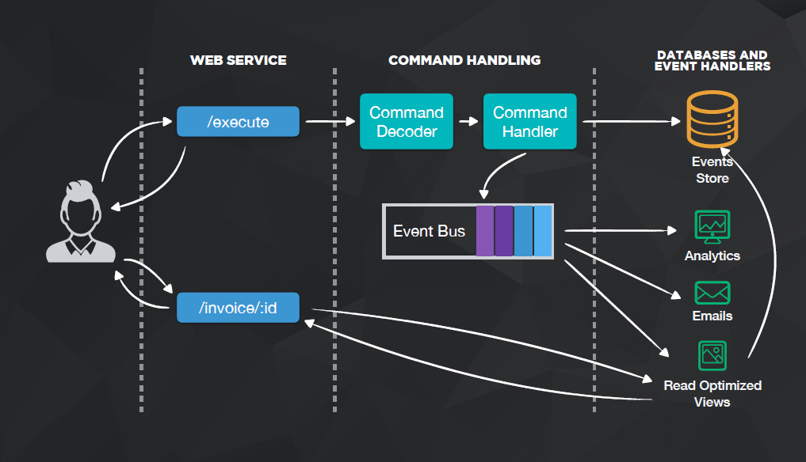

Slide 17
DEMO

